Slide 1
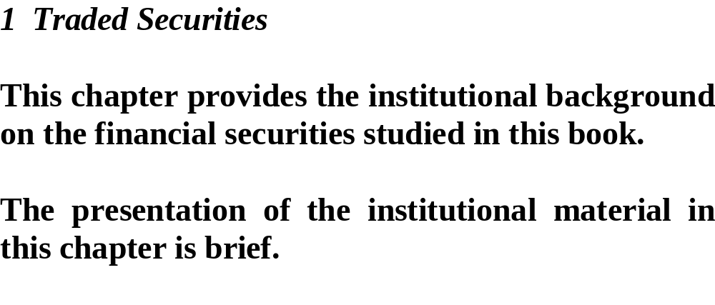
指導老師：戴天時 老師
學生：謝昌宏 周立軒

Slide 2
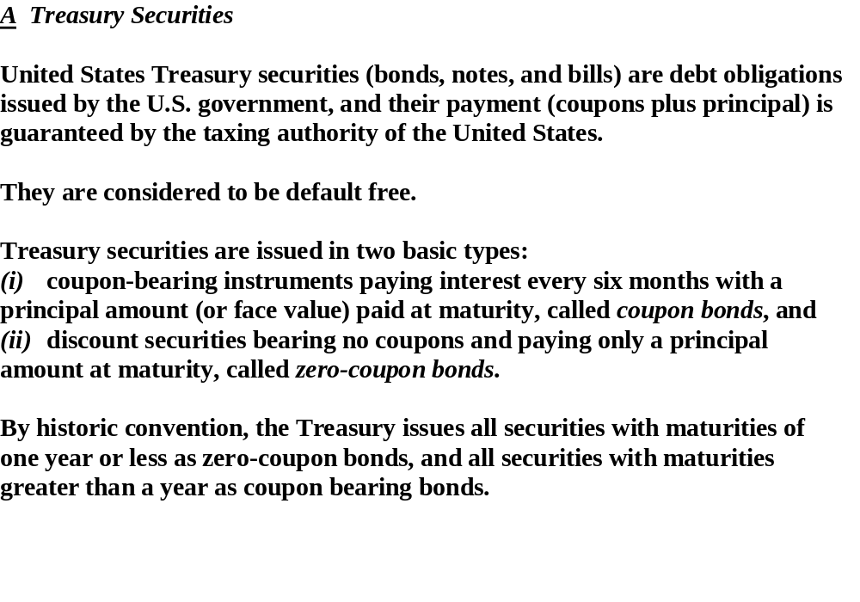

Slide 3
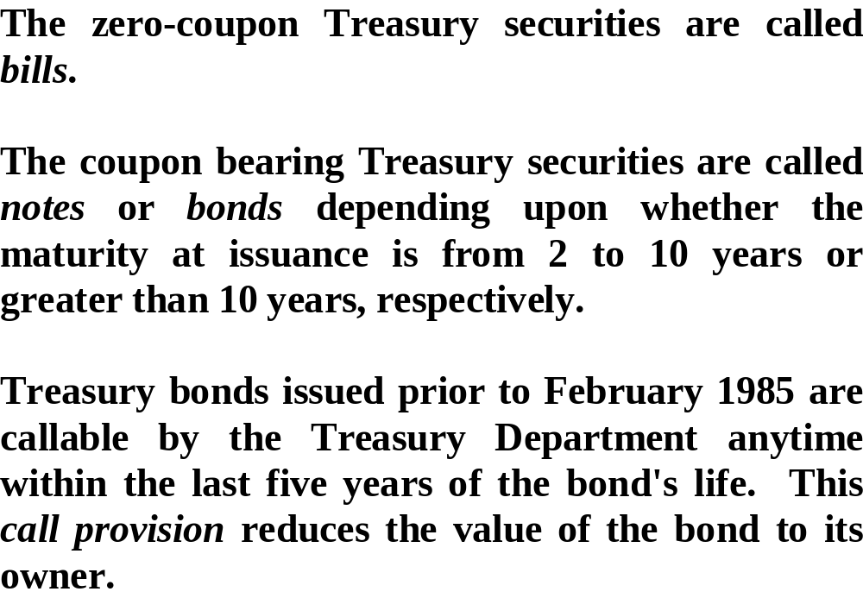

Slide 4
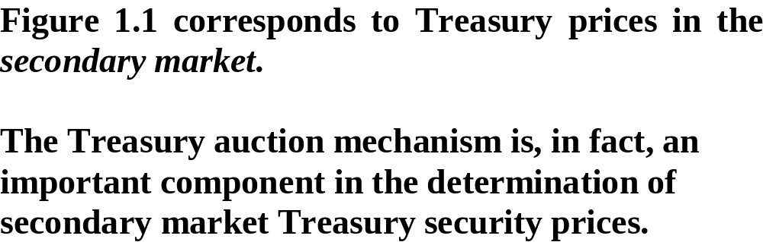

Slide 5
Figure 1.1

Slide 6
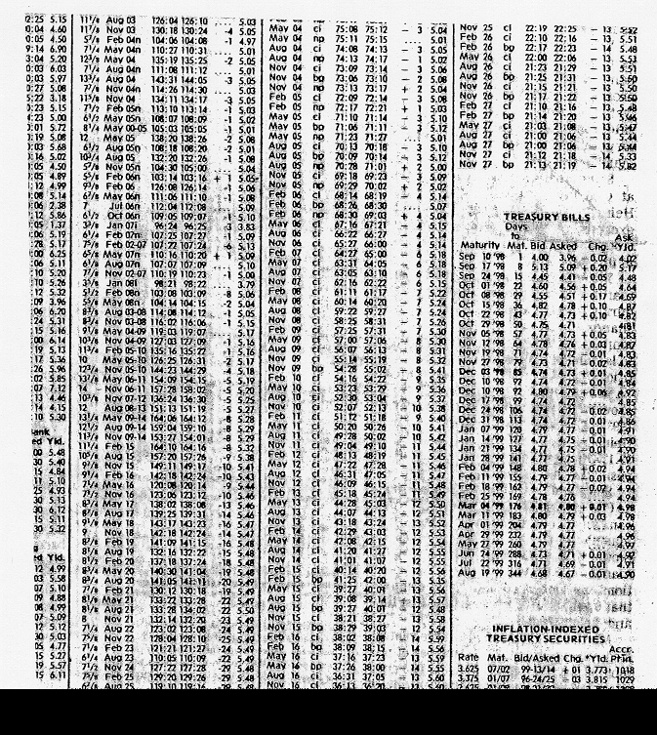
Today’s date is 1998/9/9.
There is 344 + 21 days between 1998/9/9 and 1999/9/9, so we can know that it adopted Actual/Actual.
Figure 1.1 (continued)

Slide 7
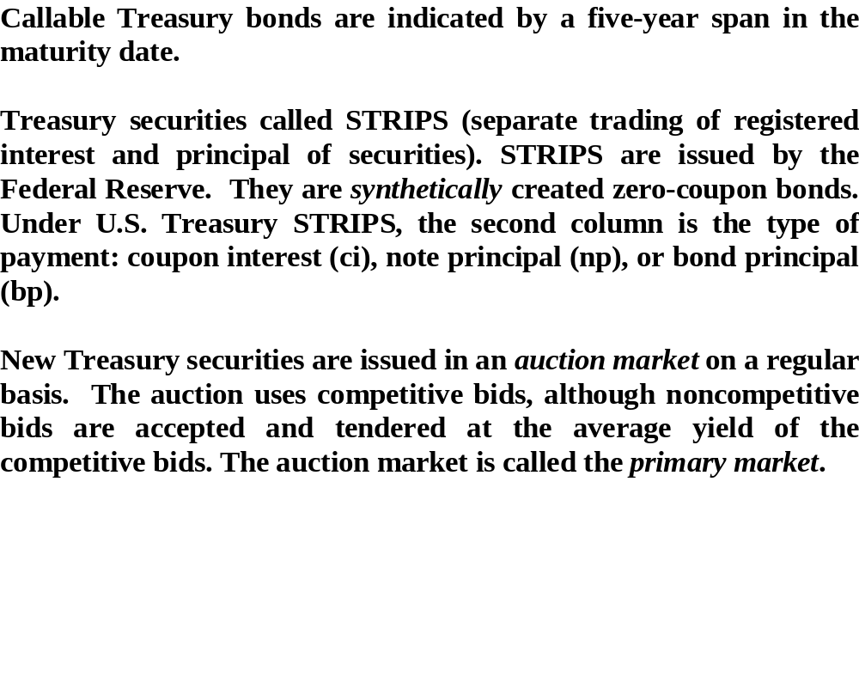

Slide 8
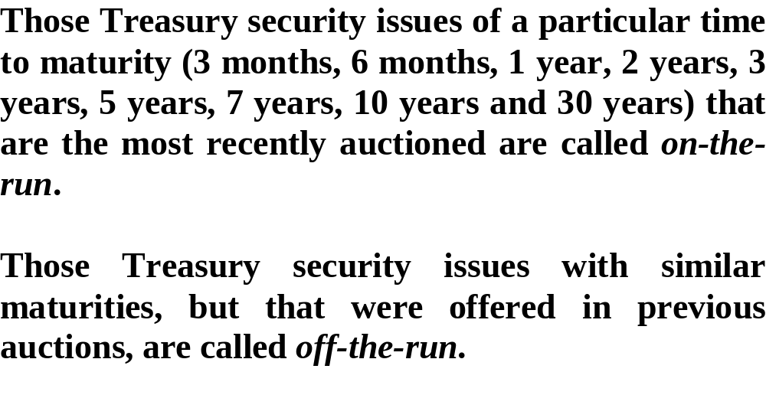

Slide 9
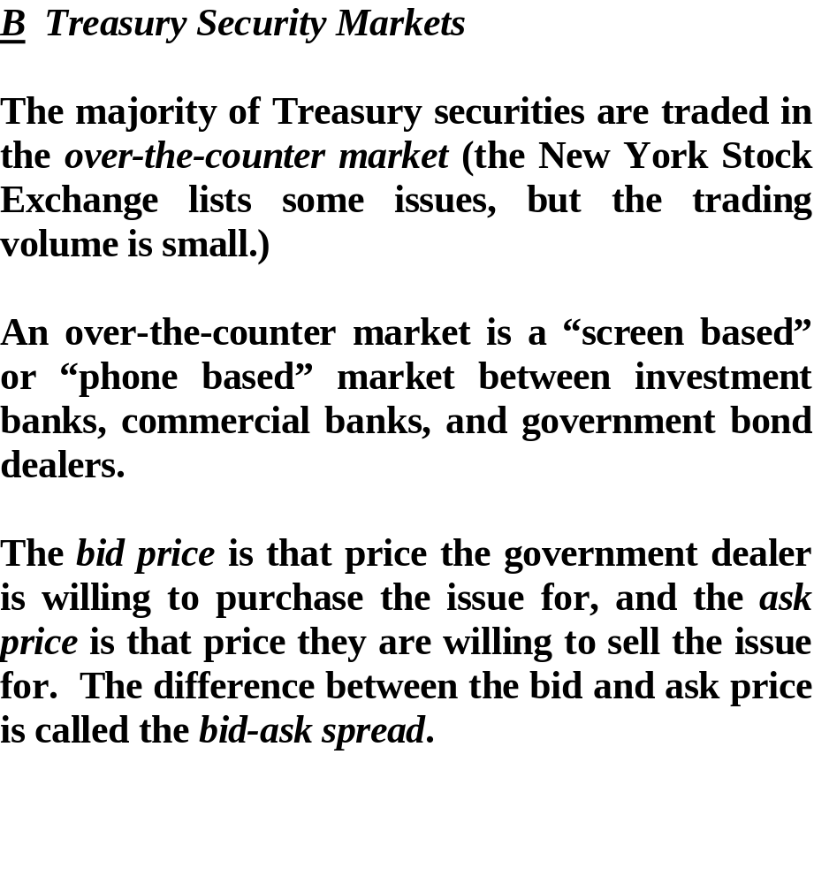

Slide 10
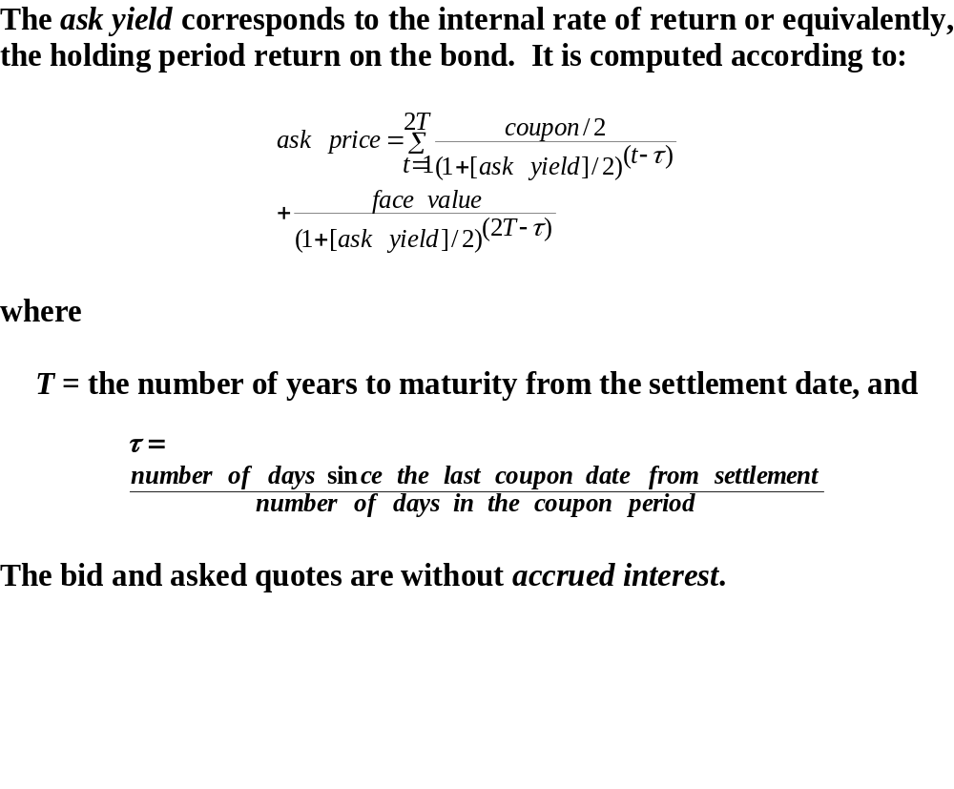
Dirty price
Dirty price – Accrued interest = Clean price

Slide 11
Ask
price
Par value
Time
Coupon payment date
maturity

Slide 12
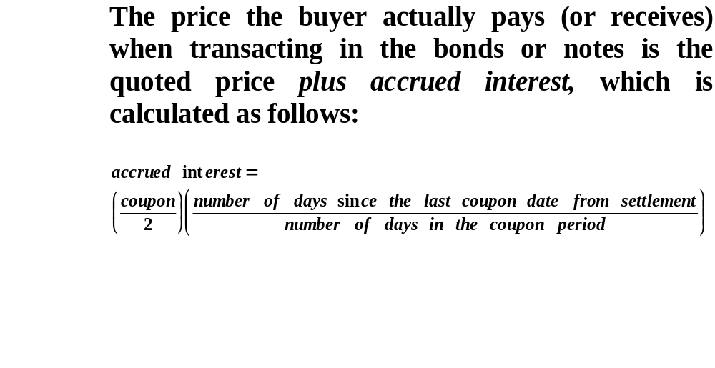

Slide 13
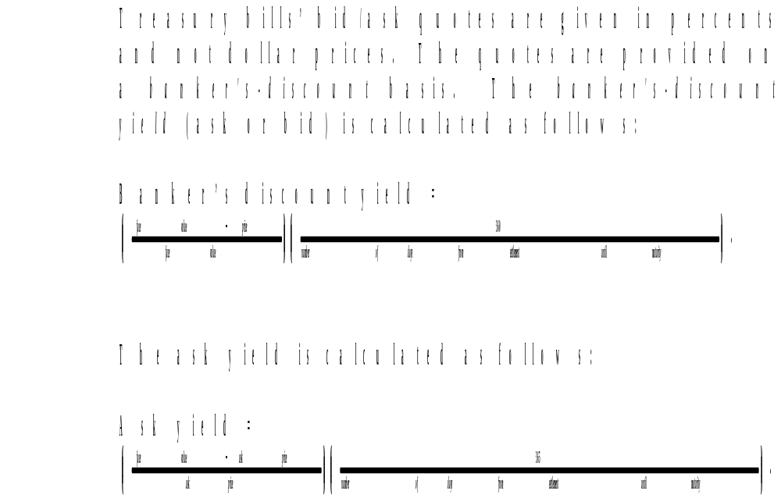

Slide 14
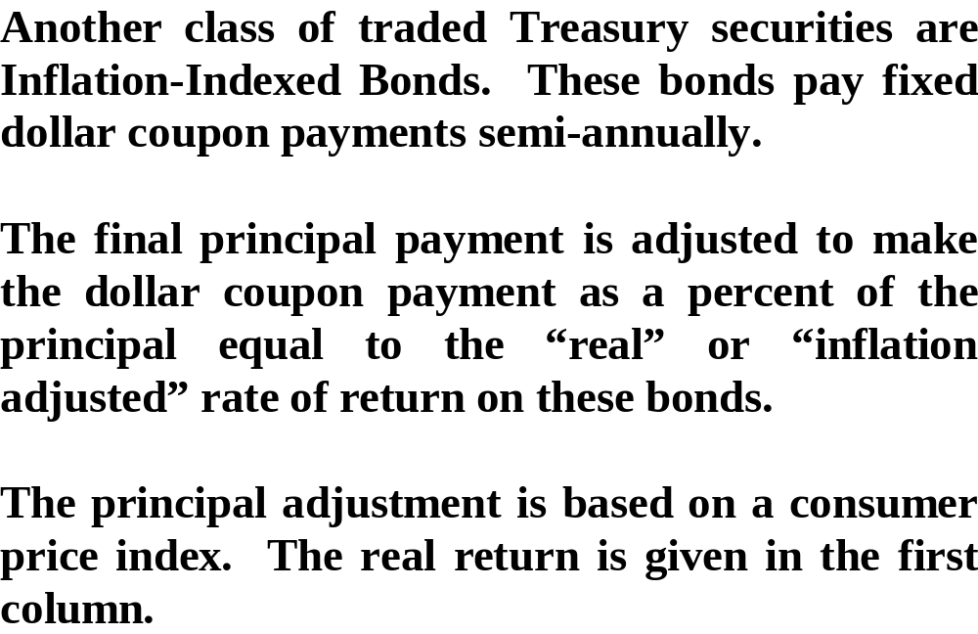

Slide 15
Appendix - Inflation Index Bonds
Inflation-indexed bonds are bonds where the principal is indexed to inflation. They are thus designed to cut out the inflation risk of an investment.
Inflation-indexed bonds pay a periodic coupon that is equal to the product of the inflation index and the nominal coupon rate. The relationship between coupon payments, breakeven inflation and real interest rates is given by the Fisher equation.

Slide 16
Appendix - Inflation Index Bonds
For example, if the annual coupon of the bond was 5% and the underlying principal of the bond was 100 units, the annual payment would be 5 units. If the inflation index increased by 10%, the principal of the bond would increase to 110 units. The coupon rate would remain at 5%, resulting in an interest payment of 110 x 5% = 5.5 units.
  by wikipedia

